Slide 1
Data Science: Big Data Management Systems & Tools
Module 10: Cloud Analytics

Slide 2
Module 10 Summary
Learning Outcomes
Define and understand cloud analytics architectures, and
Compare and contrast popular cloud analytics service offerings.

Slide 3
The promise of good data management
Cloud Analytics provides big data services hosted with a Public Cloud provider
Cloud Analytics comprise three services: Compute, Storage & Data Movement
Cloud providers can leverage open source and closed source services
Cloud analytics providers may provide support services such as DevOps and Data Governance services
Cloud Analytics can be exposed as IaaS, PaaS and SaaS
Large scale data movement is an important consideration when planning a Cloud Analytics platform
Notes:
Cloud analytics provides big data services hosted with a public cloud provider
Comprises of three services: compute, storage, data movement
Compute: is like a CPU, which is used while running a query against a dataset, or training a model,
Storage: is the holding of your data, raw, transformed
Data movement: moving data from point A to B, could be from on prem to cloud or within cloud, source to warehouse, etc
Cloud provides can leverage open and closed source services Cloud analytics providers may provide support services such as DevOps and Data Governance services
in addition to providing you services to store your data, move your data and then play with your data, using popular analytics tools like Jupyter notebook and spark
Devops would promote you code from one environment to another
Data governance policies and best practices
A lot of the cloud provides offer professional services where they can consult on multiple aspects with the cloud analytics setup
Cloud Analytics can be exposed as Infrastructure as a Service, platform as a service and software as a service
Infrastructure is the bare minimum, where they provide a server and you manage everything else
Platform is the next level up where you get infrastructure plus middleware like a database system
Last is the software, which is takes the last two and adds a front end, such as jupyter notebooks, power bi, ai applications, etc
Organization with large amounts of data that are thinking about moving to the cloud are taking on a large challenge
These projects usually take months to years to plan
Sometimes you have to physically move the data
A lot of times you rewrite your codes
This is also a good time to do a data audit to make sure data is actually being used

Slide 4
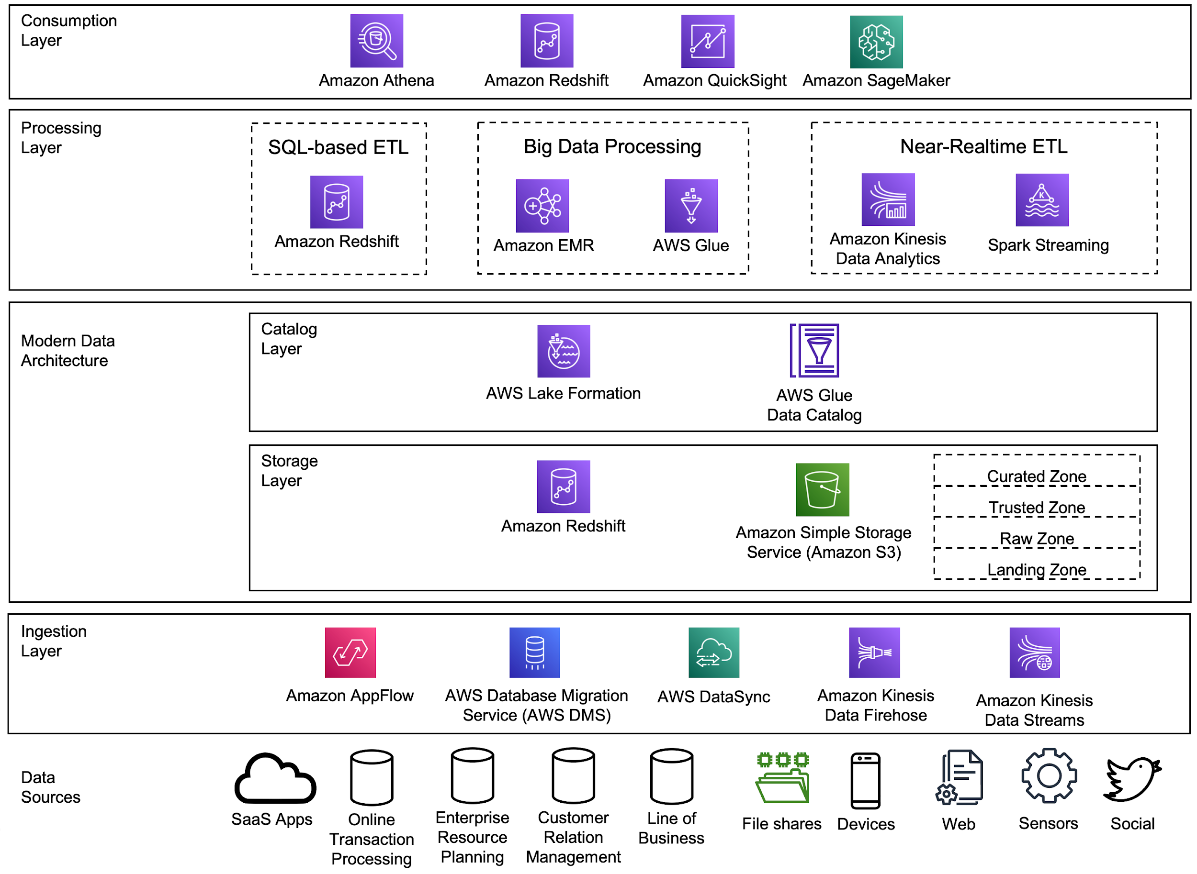
AWS
Image source: Reference architecture - Data Analytics Lens (amazon.com)
Notes:
This is a list of all the AWS services that you can use:
AWS is from amazon
Before we talk about the services, we need to look the various data sources from which we would be pulling our data
In order to pull this data we would use our first service, we use services like app flow and data sync to move data from point A to point B. Each integration service specializes within a certain area (for example kinesis data stream is primarily for sensor data)
Once you pull the data you now need the second service to store that data. The 2 most popular services from AWS are redshift (DWH) and S3 (filestore). When you put data into this storage you usually build layers like bronze, slive, gold, or raw, trusted, curated.
Above this you can have a catalogue service which stores the metadata for you data
After this you have the processing services of a few different kind
Sql based
Big data
Real time
Last but not least you have the consumption layer, where you have your athena, quicksight, etc
Note that there are more services under the AWS bucket, this is not complete

Slide 5
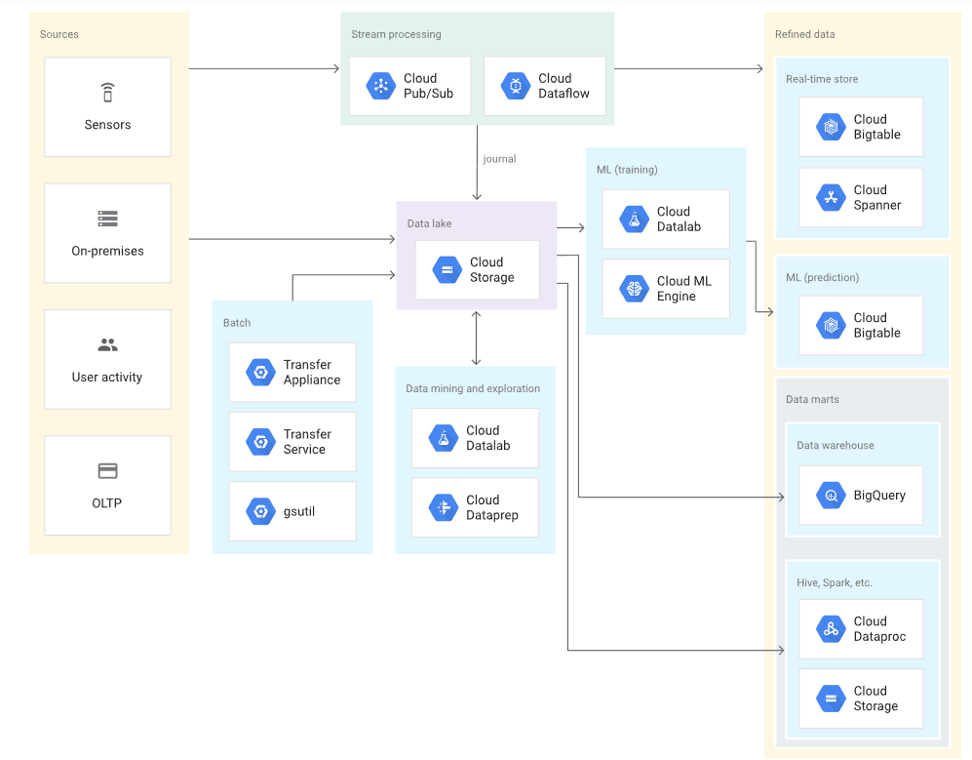
GCP
Image Source: 13 popular application architectures for Google Cloud | Google Cloud Blog
Notes:
GCP is from google
Similar to AWS, you have data sources to which you connect with and pull data
The 2 ways you can pull the data are via streaming or batch ingestion
for steaming you have pub/sub and dataflow
pub/sub is like a kafka
Dataflow is more like a traditional ETL where you can transform the data as its being ingested
For batch you have gsutil, transfer service, and transfer appliance
Once ingested you can land the data into a storage and in this case its called google cloud storage
From there you can move it to a warehouse like bigquery for sql level work or bigtable for real time work
For ML work you can use cloud dataproc which is similar to spark

Slide 6
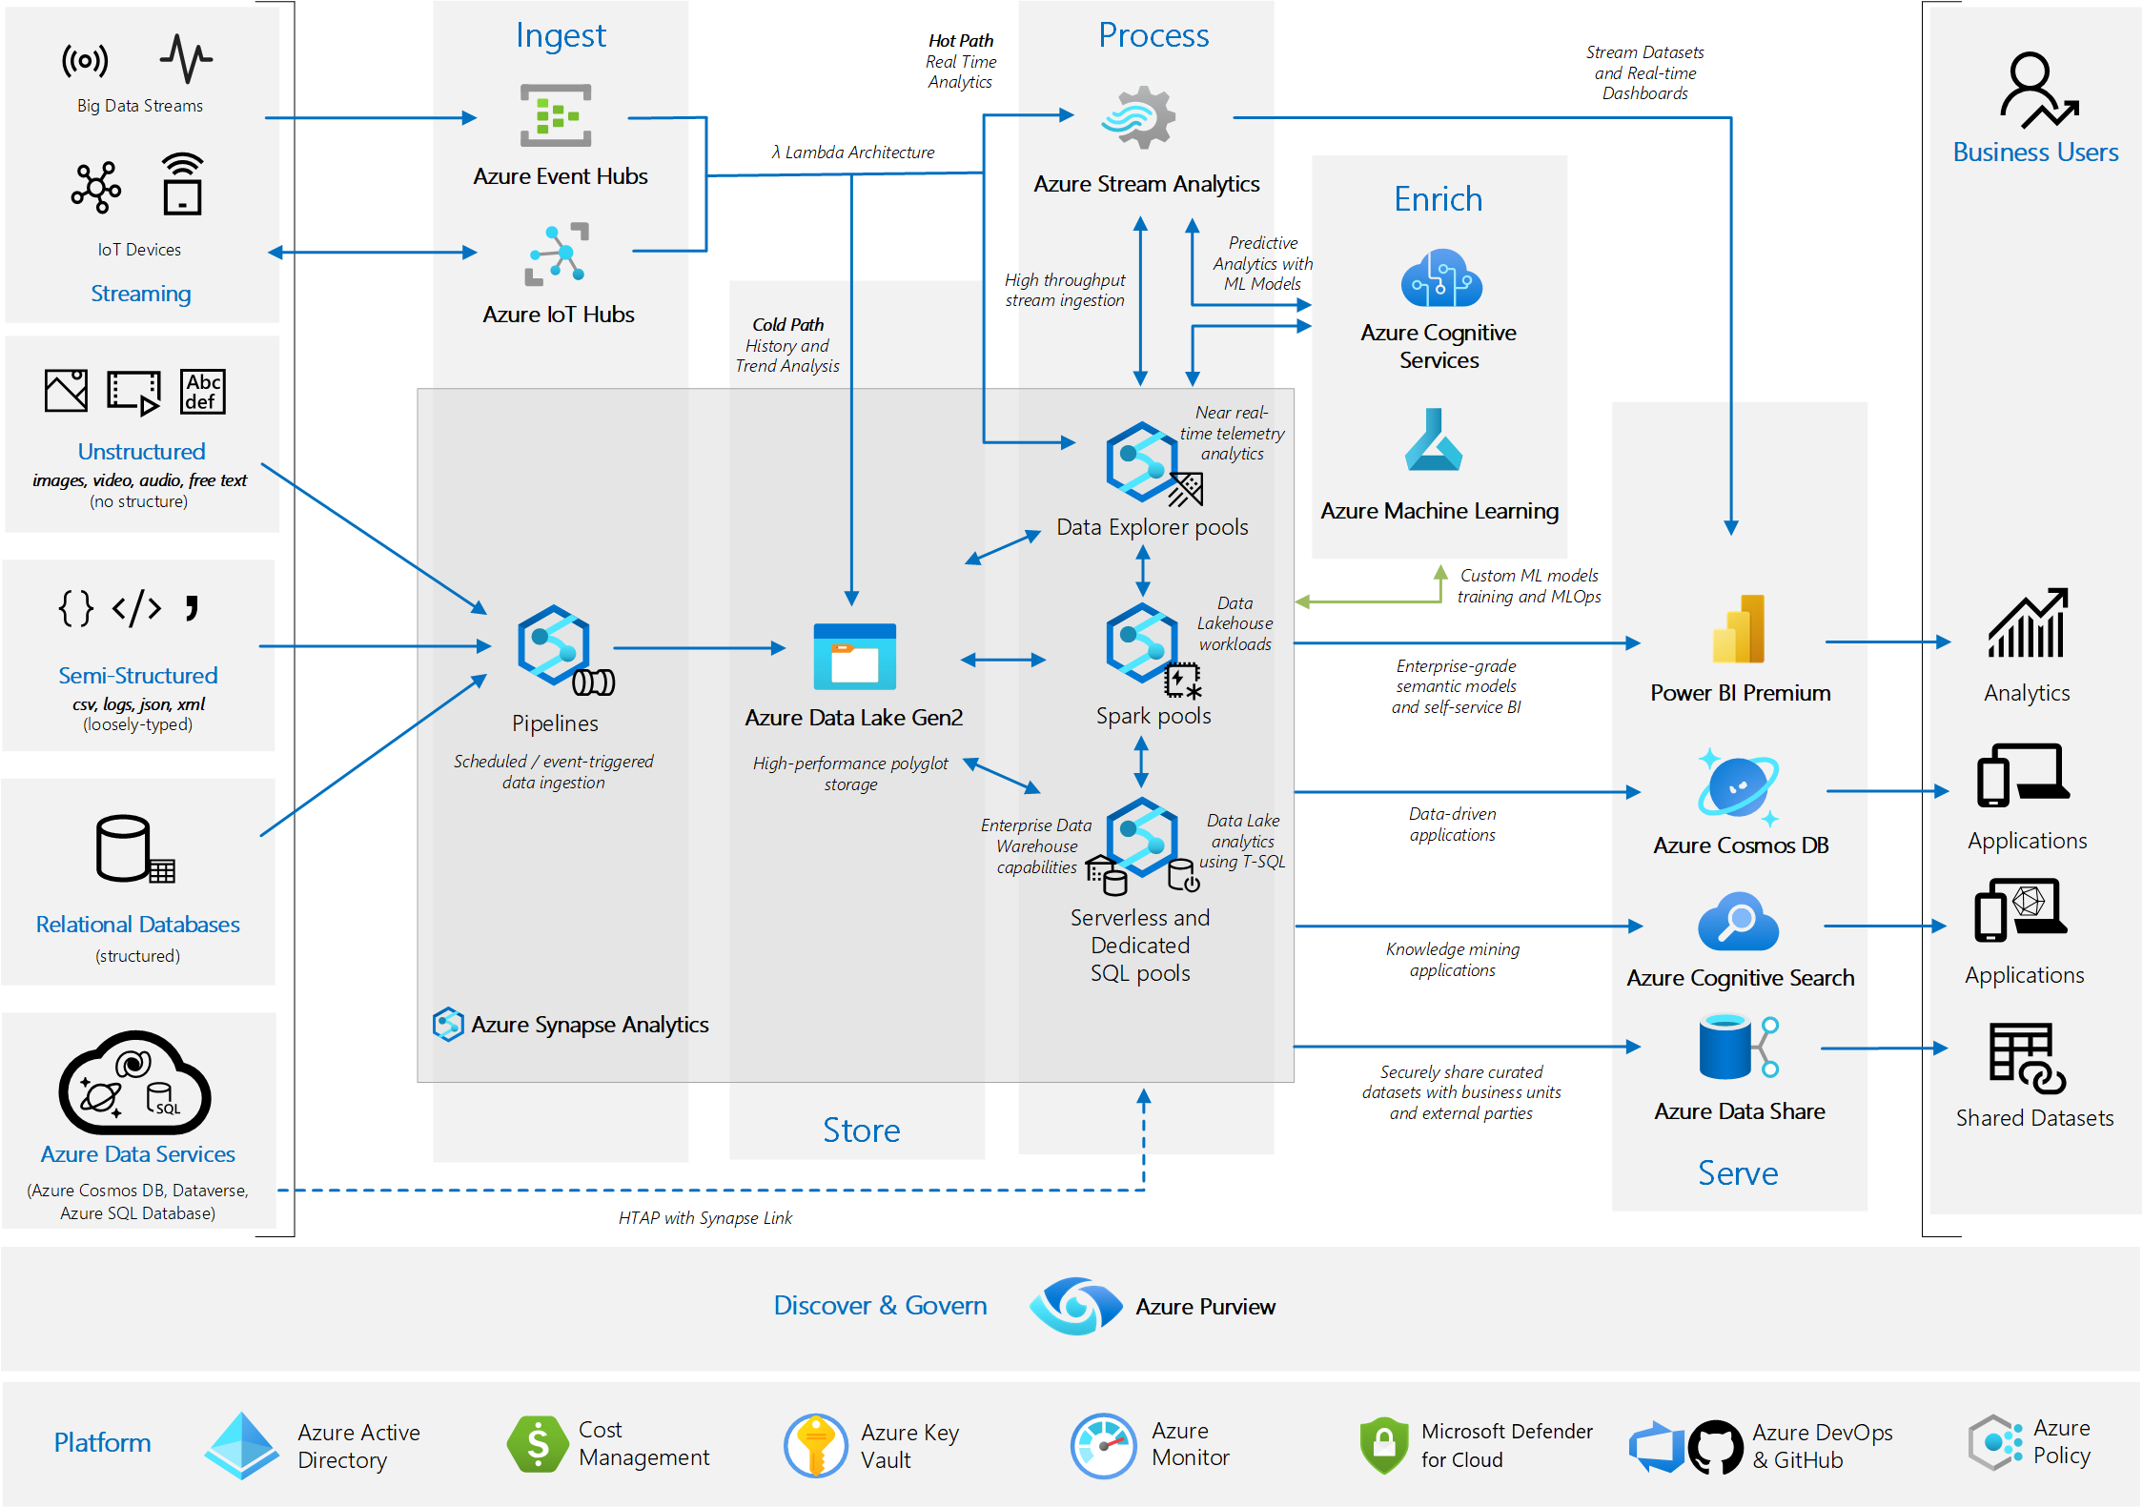
Azure
Image source: Analytics end-to-end with Azure Synapse - Azure Architecture Center | Microsoft Learn
Notes:
This is an example with Azure:
Left hand sides are our sources, sensors data, unstructured, semi structured, structured data
The ingestion tool here is done through a native setup with data lake gen2
From there you can have specific pools where the data is processed
Data explorers
Spark
Sql pod
From there you have you combustion tools, like power bi and data share

Slide 7
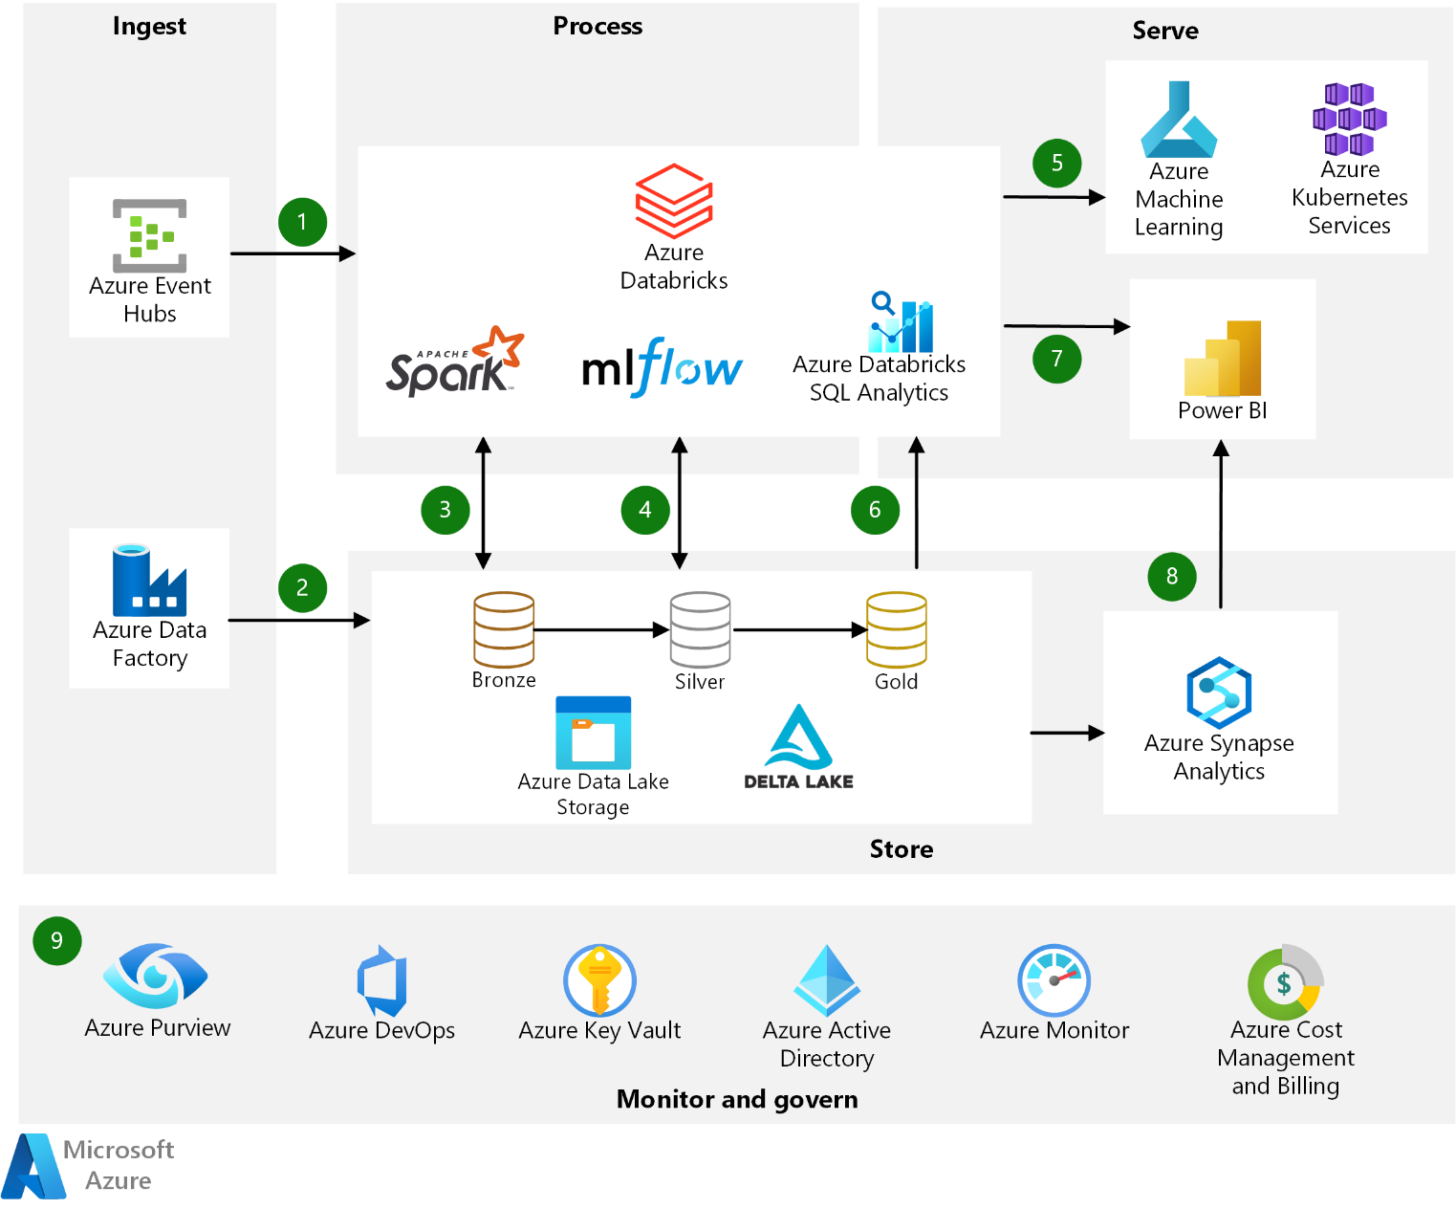
Azure Databricks
Image source: Modern analytics architecture with Azure Databricks - Azure Architecture Center | Microsoft Learn
Notes:
So with databricks you have a very similar setup as Azure, except the processing can be done via azure databricks. Other platforms also offer databricks, but not as first party service.
Databricks is well integrated with other azure services like data lake storage, synapse analytics, ML

Slide 8
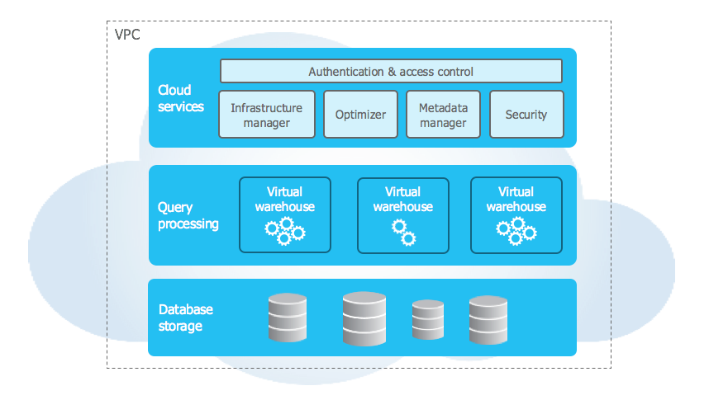
Snowflake
Image source: Key Concepts & Architecture — Snowflake Documentation
Notes:
Snowflake is another popular tool
Allow you to host your datalake and data warehouse in one place
Snowflake does have some in built ingestion functions but not at powerful as the other cloud providers.
Snowflake is usually used in conjunction with other tools like:
fivetran, stitch, for ingestion
Dbt, coalesce for transformation
Tableau, power bi for BI

Slide 9
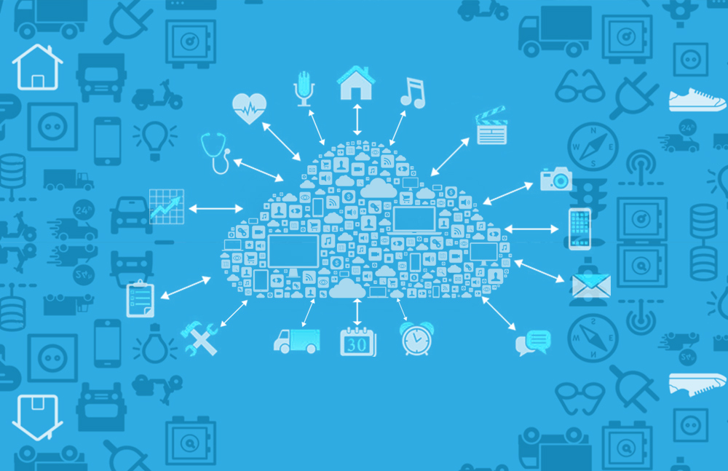
Why is this important?
Using a cloud vendor when working with big data is easier than setting up all the infrastructure and tools yourself. Most of the most popular tools are available through multiple cloud vendors enhanced with their own proprietary toolset.

